Slide 1

LAW FIRM MODELS FOR DOCASSEMBLE: SUSTAINABILITY, METRICS, INTEGRATIONS, AND BUY-IN
Robert Hudock
King & Spalding
Dorna Moini
Documate

Slide 2
Agenda
Background and Landscape. 3-5
What We love about Docassemble. 6
Lessons Learned. 9
Ideas to Make Docassemble Even Cooler. 12
Notes:
Use only for Agenda/Table of Contents

Slide 3

Background
Partner with King & Spalding; Colleague Consultant at K&S (Formerly VA Security Expert).
Learned Python participating in CTFs.
Expert systems around 2001. Intrigued by Shyster (written by James Popple) available at http://users.cecs.anu.edu.au/~James.Popple/publications/books/shyster.pdf
Focus on privacy and security compliance and breaches.
Interested ontological insights and nature of consciousness; most work is simple.

Slide 4
Background
Co-Founder of Documate (a no-code platform for building Docassemble interviews).
Formerly IP and employment litigator at Sidley Austin.
Discovered document assembly through legal aid work (HelpSelf Legal platform).
Goal to make Docassemble accessible to everyone through secure setup and teaching code

Slide 5
Future of Professions
“ [t]he future has already arrived. It’s just not evenly distributed yet.”
― Richard Susskind, The Future of the Professions: How Technology Will Transform the Work of Human Experts

Slide 6
Landscape.
Innovation required, need to give people a product to sell, and/ or buy.
Law firms are ripe for disruption, firms technology handicapped.
Need product that makes your client look good.
Hours remain the key arbiter of value, clients however continue to expect more– the More for Less Problem.
Cost Matters: Jnana (now Neota) ($$$$) (inference corporation), Adobe LiveCycle ($$$), Orbeon Forms ($) (Interviews) & Altova StyleVision ($$) for report generation, and now Docassemble (free).
Build something that you can leverage to fulfill current client needs.

Slide 7
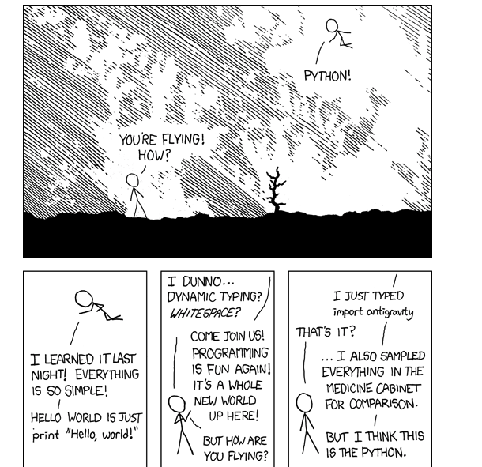

Slide 8

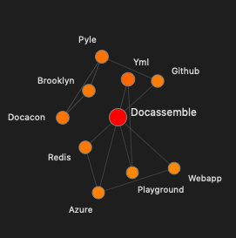
Docassemble is awesome.
Open Source; Componentized; Object Oriented; No Blackbox; No vendor lock-in.
Leverages common technologies, and components.
Includes document generation, where templates can be created/ edited in Microsoft Word using Jinga.
Handles complicated iterative data structures very well. Historically this has been one of my biggest problems.
Able to start small and scale up.

Slide 9
Docassemble is awesome.
Non-technical folks can use Docassemble!
Start with simple use cases
Learn with the system → Complexity
Infinite complexity through API, oauth, webhooks, and other integrations
Accessibility features
Notes:
Simple use cases are easy on Docassemble. We build a front end that sets up your questions, adds logic, and populates documents for document assembly.
But we also provide our users the option of seeing the Docassemble code below the user interface, and so far have been able to learn from looking at how
Because of the simplicity of learning Python, basic document assembly is easy after an initial learning curve. And some lawyers we talked to actually found it fun.
Send text messages and notifications
Accessibility features to increase the scope of the audience: screen reader, audio interview, visuals, label tags that facilitate

Slide 10
Lessons Learned

Slide 11
Practical Knowledge Engineering
“ A miser was drowning in a river. A passerby on the bank called out to him, ‘Give me your Hand’. The drowning miser refused. The passerby changed his plea ‘Here! Take my hand!’ Finally the miser reached out to save himself.
―Richard Kelly, Practical Knowledge Engineering

Slide 12
Keys to Success with Expert Systems
Read and Re-read Practical Knowledge Engineering by Richard Kelley, JR. Excellent technology neutral recommendations for identification of use cases, and practical implementation guidance.
To go primetime, user education is key takes as much time to build the product as to re-engineer workflow to be intuitive for a non-subject-matter expert.
Engage in endless self-promotion. Hard for engineering focused individuals; get a good CEO.
Reinvest time saved through efficiency to enhance the product.

Slide 13
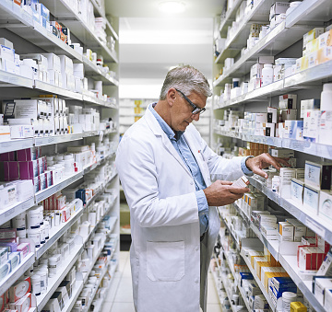
About our use case.
Application logic very complex takes about 15 minutes to run a report.

Slide 14
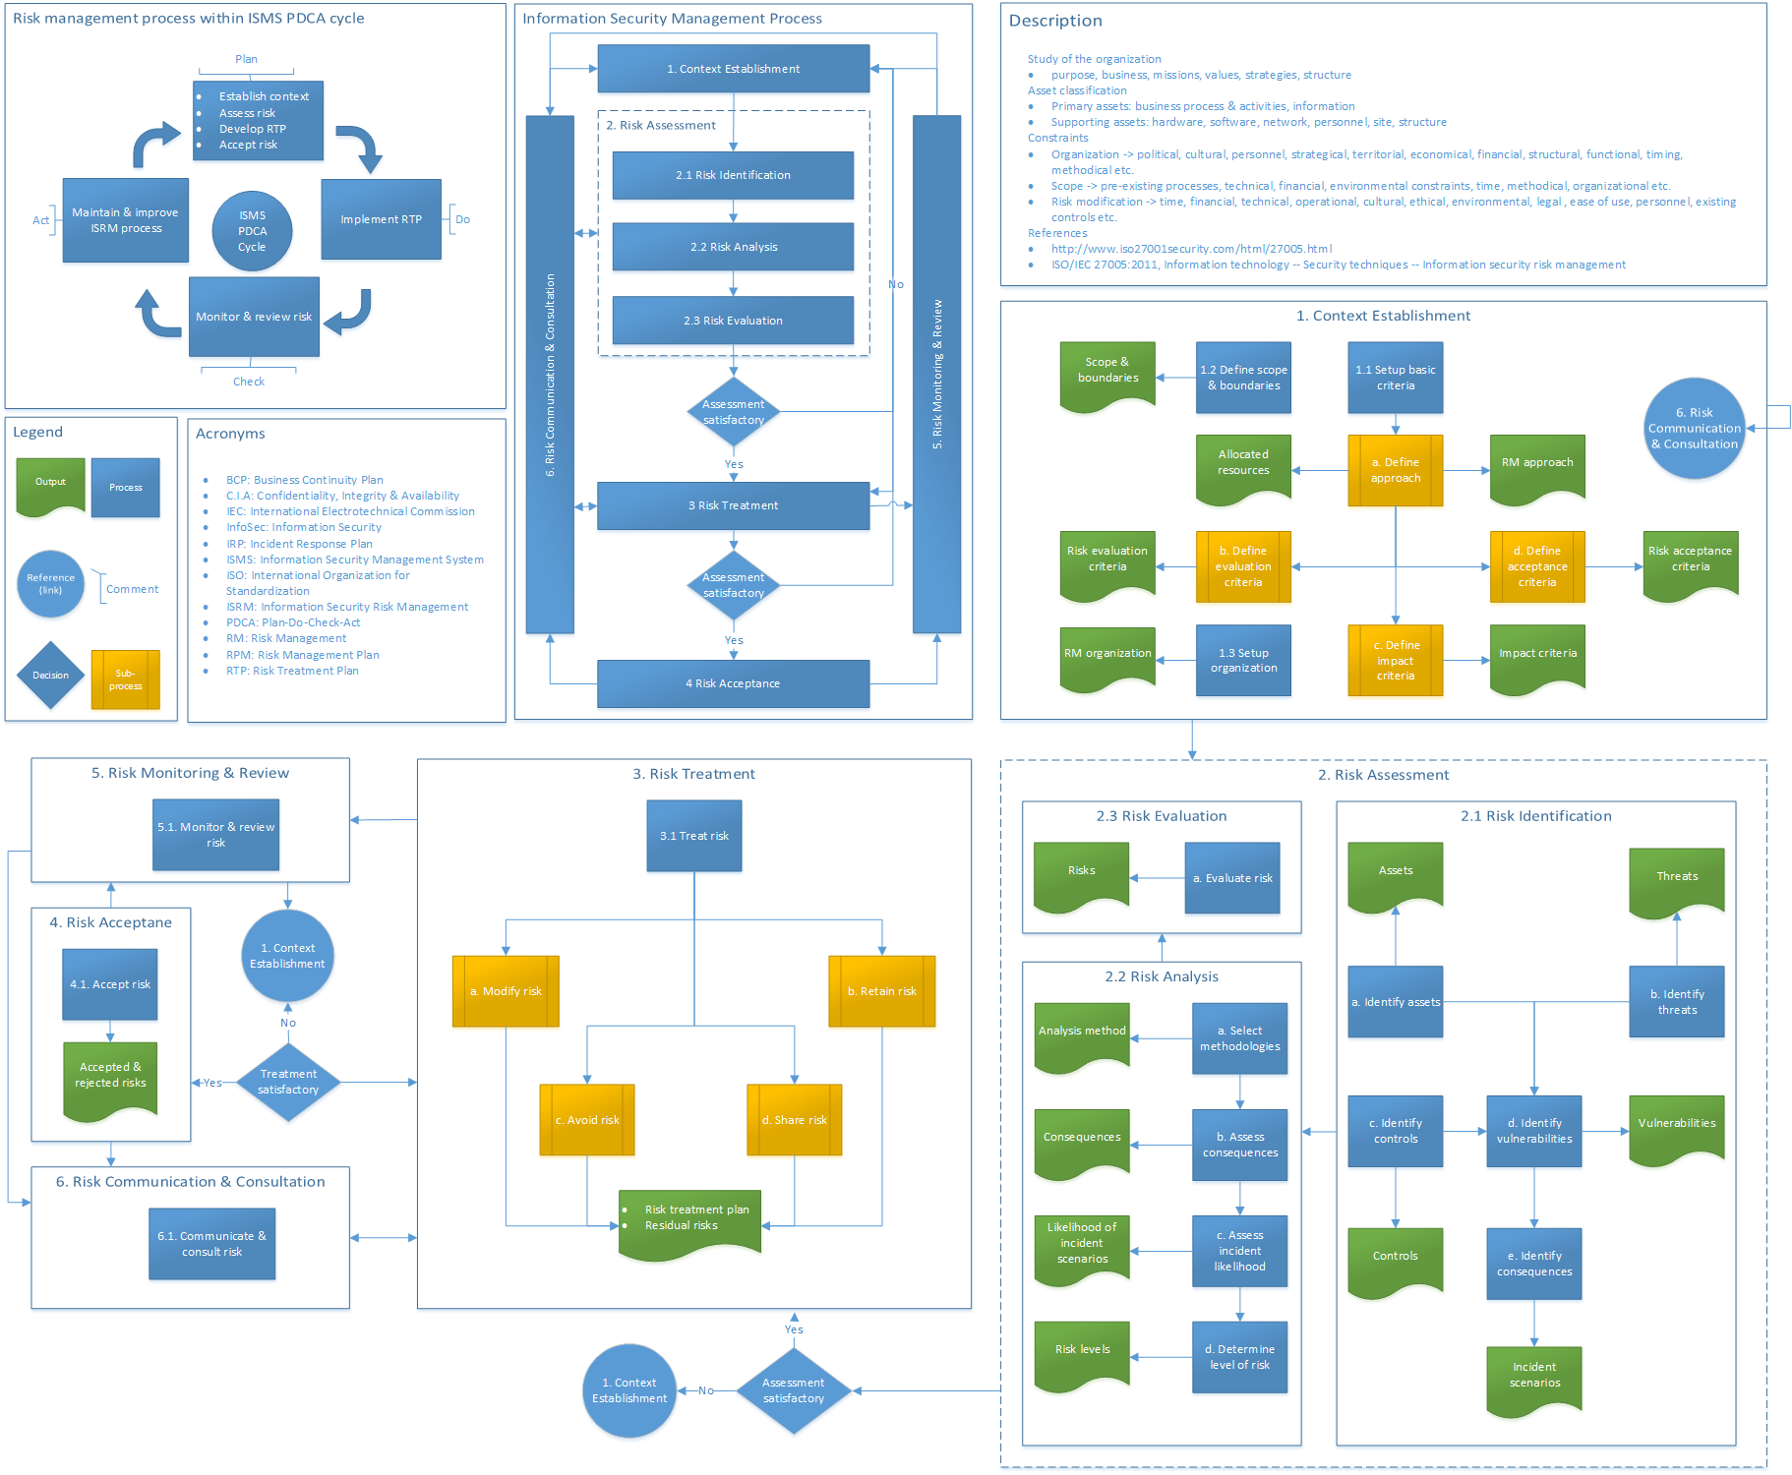

Slide 15
Trials and Tribulations of Using Docassemble in Production
Challenging when deployment model deviates from examples.
Moving to RDS requires familiarity with Docassemble initialization.
Potential impact of updating not well understood.
Some defaults may not be sensible (encrypted interviews)
Ability to meet enterprise security requirements.

Slide 16
How to get smaller firms on board
Intake is the gateway drug to document automation.

Slide 17
Common use cases
Intake
Free web tools
Capture revenue and increase volume through Stripe integration
Branded client portals
Full scope workflow management
Notes:
Data input, data output, CRM, text notifications, hearing reminders

Slide 18
Our user research on efficiency, quality & revenue
Cuts document prep time by 85%
Cuts error rate down to nearly zero
Increases potential volume 10x
Revenue boosts between $100 to $15k/month in first few months
Work-life balance and job satisfaction…priceless
Notes:
Data input, data output, CRM, text notifications, hearing reminders

Slide 19
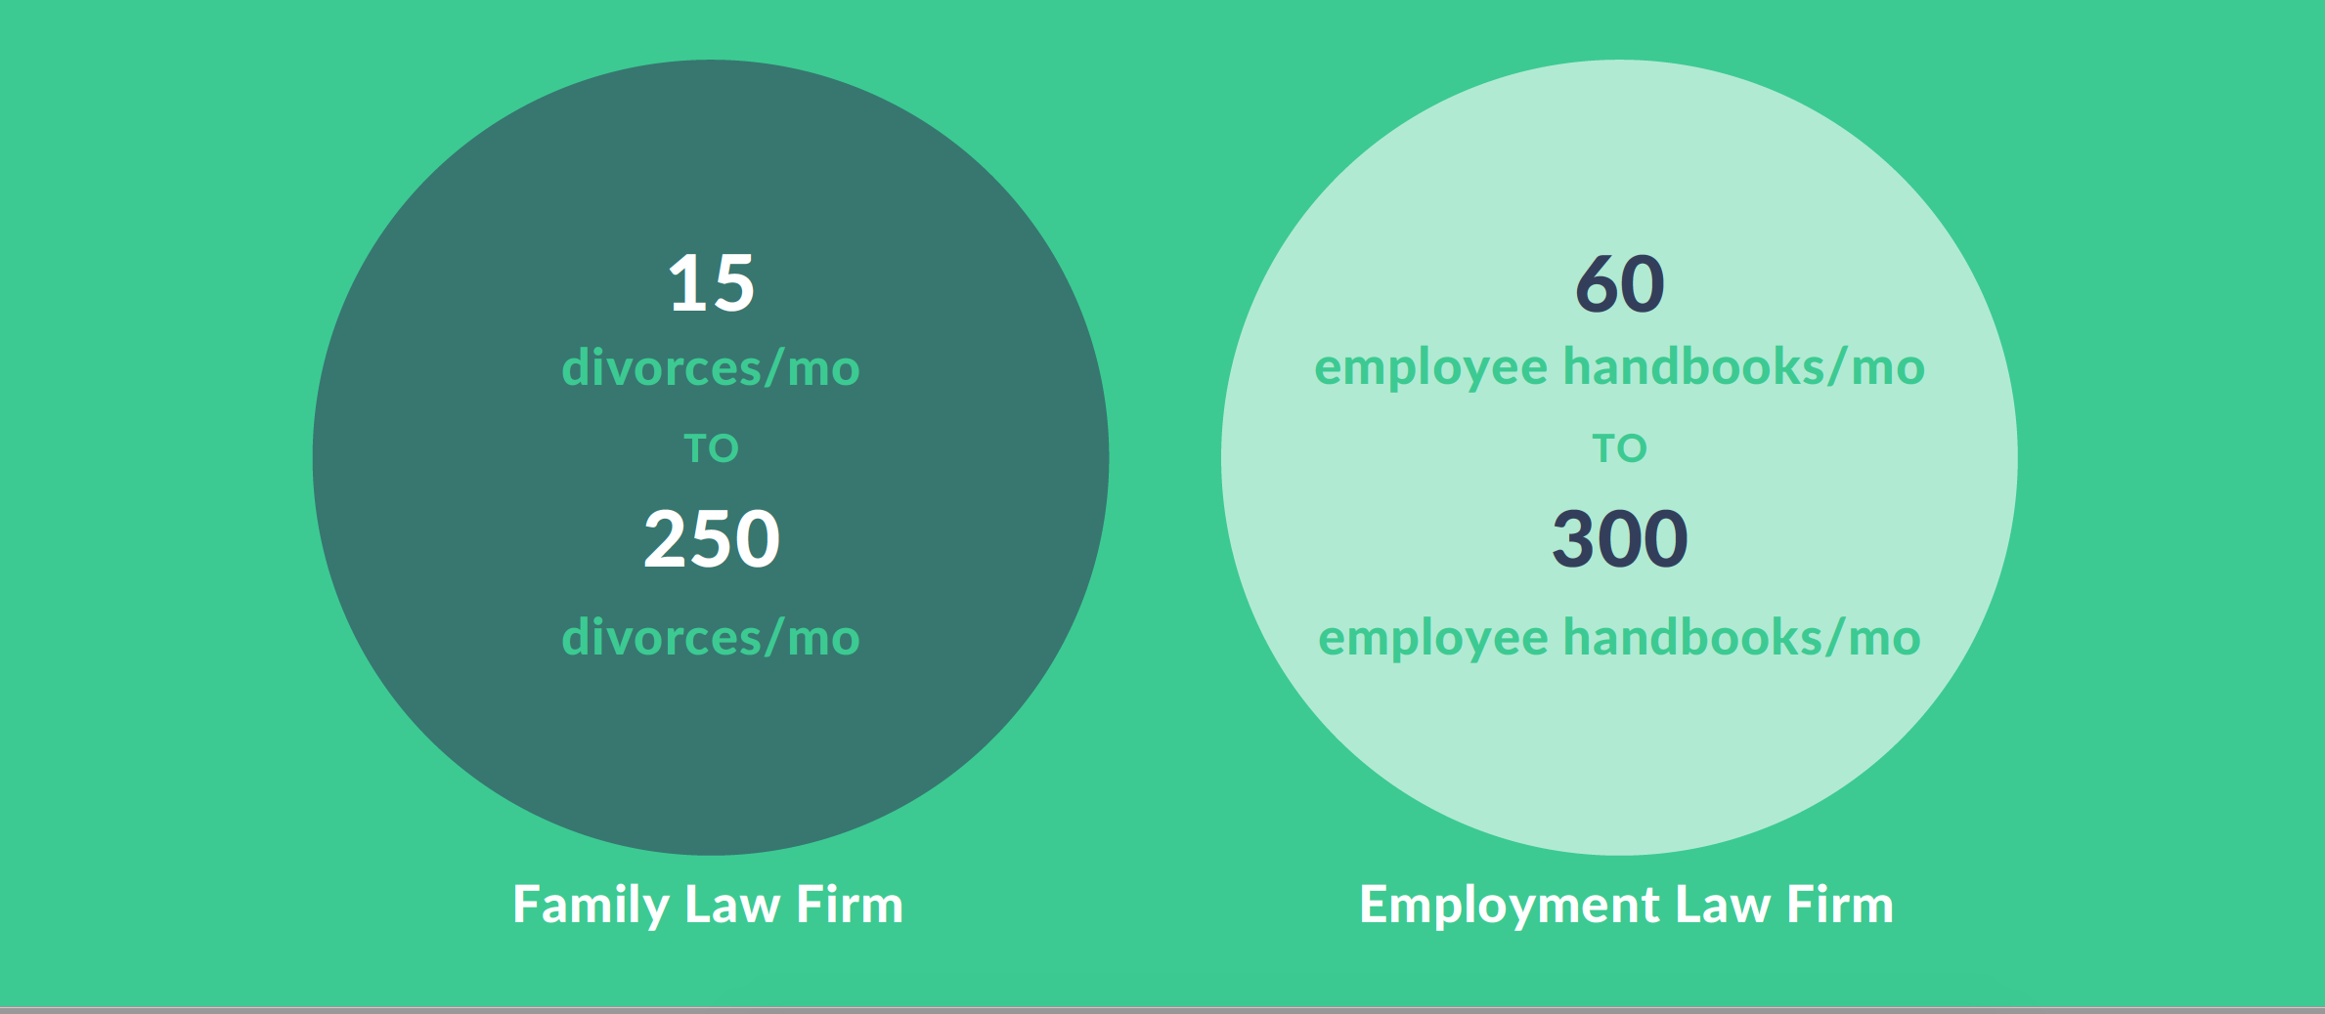
Case studies
Notes:
Data input, data output, CRM, text notifications, hearing reminders

Slide 20
Ideas to Make Docassemble Even Cooler.

Slide 21
Ideas for the future
Security Testing.
Setup 501(c)(3) for donations and project support.
UML Diagram of Application Flow, Graph Database Integration.
Continue to build a library of useful Python functions.
Keep a history of the Docassemble slack channels.

Slide 22
Questions
LAW FIRM MODELS FOR DOCASSEMBLE: SUSTAINABILITY, METRICS, INTEGRATIONS, AND BUY-IN
Notes:
SHOW End-slide

